Slide 1




Los Angeles Center for Photography
Northeastern University, Boston
ALY 6080 Integrated Experiential Learning
Professor: Valerie Atherley
June 20th, 2023
Group Members - Dhara Photowala, Sanover Tasneem
Sameeksha Santosh, Simran Srivastava, Srishti Singh

Slide 2

AGENDA
➢ Overview of the Project
➢ Business Problem
➢ About Dataset and Data dictionary
➢ Roadmap of the Project
➢ Data Preparation : Cleaning
➢ Exploratory Data Analysis
➢ Findings: Dashboard Visualization
➢ Future Research
➢ Conclusion
➢ Q/A

Slide 3

OVERVIEW OF THE PROJECT
Our Collaborative project with sponsor LACP focused on the development of a Portfolio Reviews Program.
Objective: Efficiently match attendees with their preferred reviewers and generate optimal schedules.
Key Milestone:
- Utilizing Python programming language.
- Implementing advanced algorithms.
- Employing data structures for sorting, matching, and scheduling.
- Aim to enhance the efficiency and effectiveness of the Portfolio Reviews Program.
- Seamless experience for both attendees and reviewers.

Slide 4
BUSINESS PROBLEM
LACP is facing a problem with an inefficient portfolio review process that is not optimized, resulting in improper matches between attendees and their preferred reviewers.
The current scheduling system is manual, which is time-consuming and prone to human errors.
Attendees and reviewers are dissatisfied with their experiences when they are not matched with their preferred choices.
There is a lack of automation or a program to efficiently pair participants with their preferred reviewers and generate ideal schedules.

Slide 5

DATASET AND DATA DICTIONARY
Dataset Overview
100-person online portfolio review session with 40 reviewers.
Attendees indicate either 5 or 8 reviewer preferences and availability.
Reviewers have availability for 1, 2, or 3 sessions across 4 days.
Additional Information
Center's program and event dates.
Number of sessions and workshops offered.
Bios of participating reviewers.

Slide 6
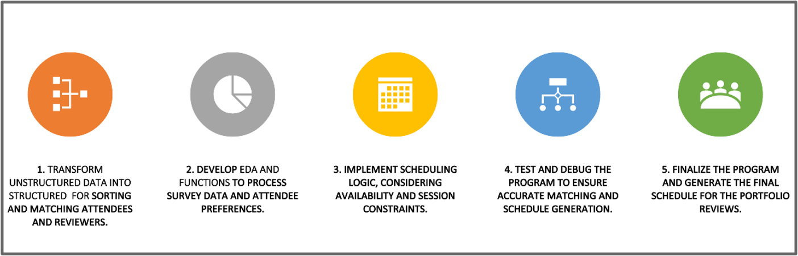
ROADMAP OF THE PROJECT

Slide 7
DATA PREPARATION: CLEANING
Clean up session survey information by removing special characters and formatting inconsistencies.
Profile data to identify issues like missing values, duplicates, and inconsistencies for data quality assessment and cleansing.
Rearrange time frame columns for each chosen session of attendees.
Transform and sort reviewer names and ratings to determine popularity among attendees.
Clear plan, defined procedures, and effective communication are crucial for successful data preparation.
z

Slide 8
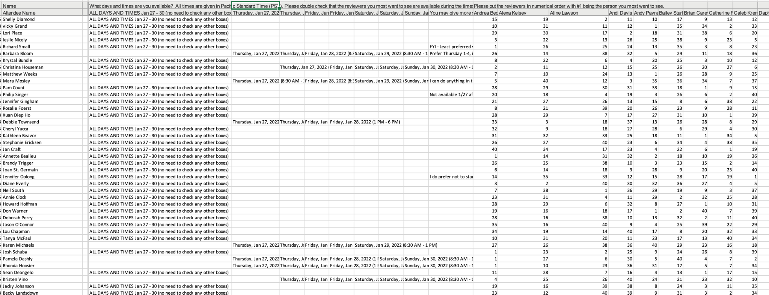
RAW DATASET
z

Slide 9
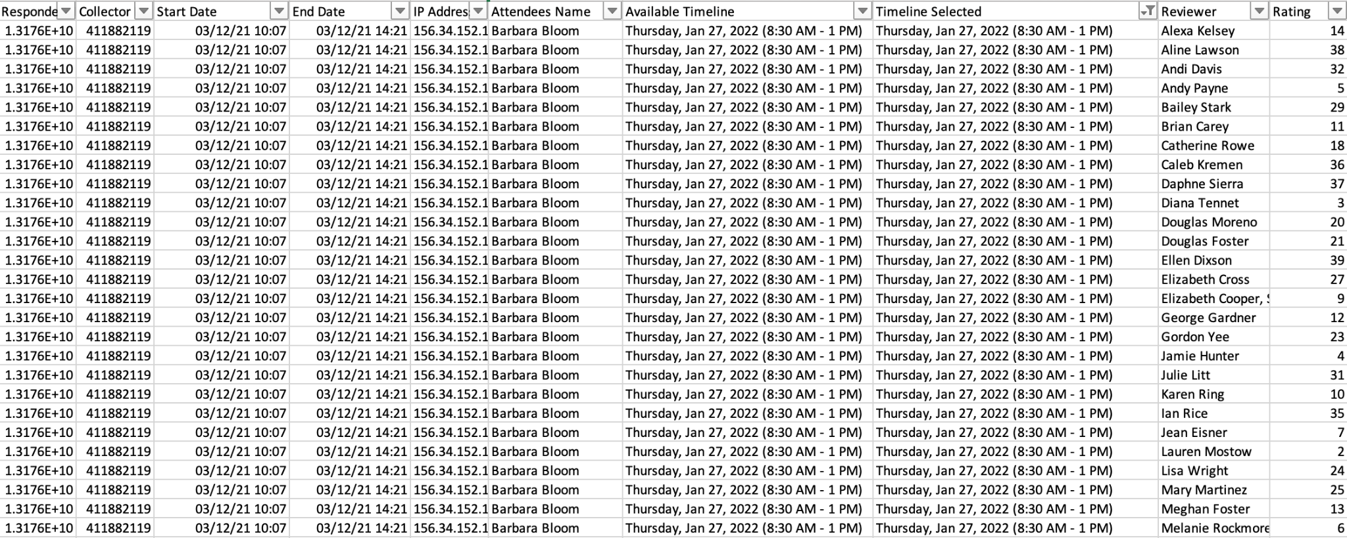
CLEANSED DATASET
z

Slide 10
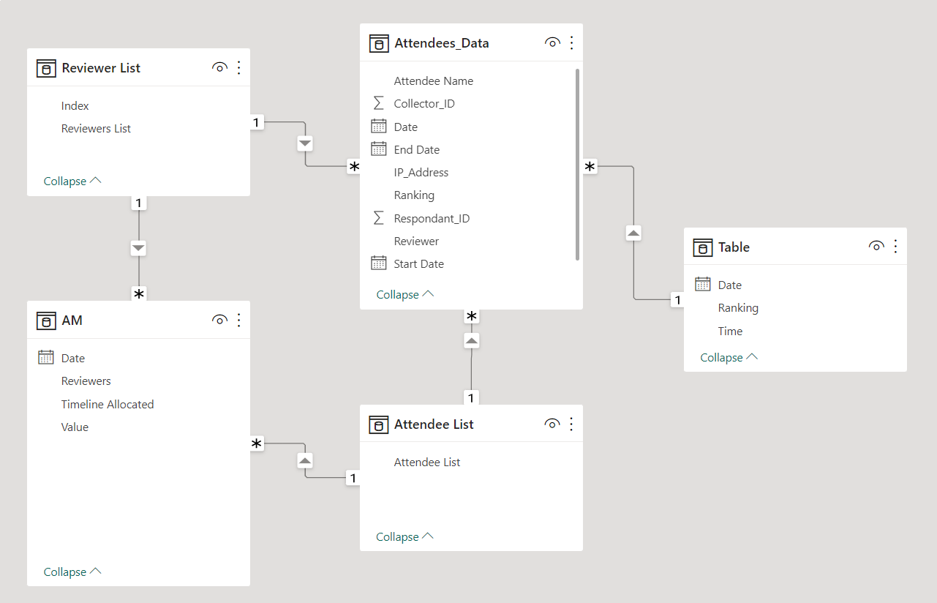
SCHEDULING DATA MODELLING
The data modeling helps organize and analyze the data for efficient scheduling of portfolio reviews.
By leveraging the relationships between tables and columns provided, we can create visualizations and apply algorithms to match attendees with reviewers.
Power BI Desktop enables us to generate a final schedule that ensures attendees meet their preferred reviewers in suitable time slots.
The scheduling developed will enhance the overall experience of the online portfolio review event for attendees and reviewers.
z

Slide 11
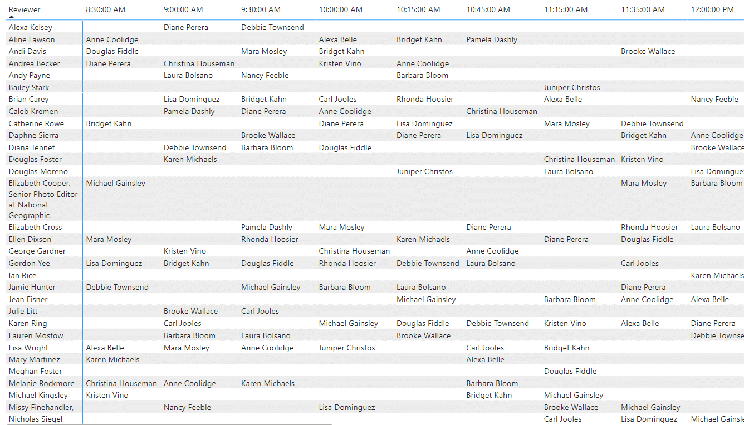
SCHEDULING
The data modeling helps organize and analyze the data for efficient scheduling of portfolio reviews.
By leveraging the relationships between tables and columns provided, we can create visualizations and apply algorithms to match attendees with reviewers.
Power BI Desktop enables us to generate a final schedule that ensures attendees meet their preferred reviewers in suitable time slots.
The scheduling developed will enhance the overall experience of the online portfolio review event for attendees and reviewers.

Slide 12
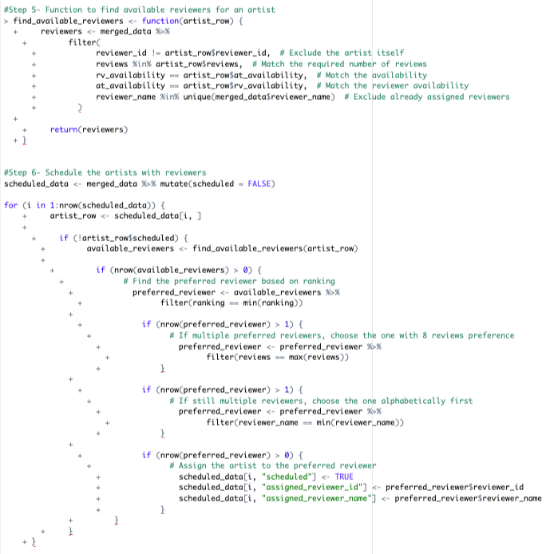
SCHEDULING CODE SNIPPET
The code performs a scheduling process to assign artists to available reviewers based on certain conditions.
It merges data from multiple Excel files to create a comprehensive dataset for scheduling.
A function is used to check if two time slots overlap, ensuring that reviewer and artist availability align.
The code iterates through the data and finds available reviewers for each artist, considering factors such as ranking and number of reviews.
The final output is a schedule table that displays the assigned reviewer for each artist, facilitating the review process.
z

Slide 13
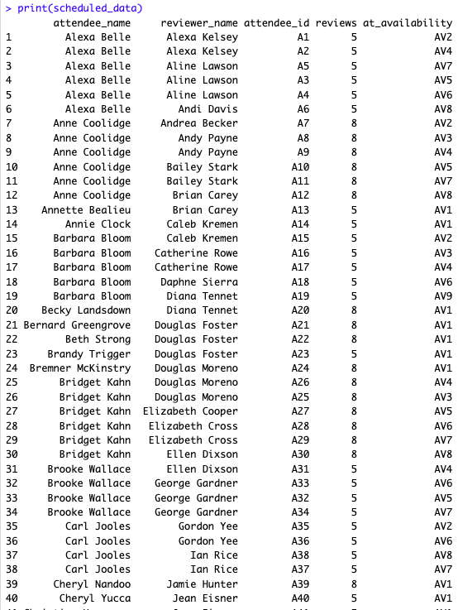
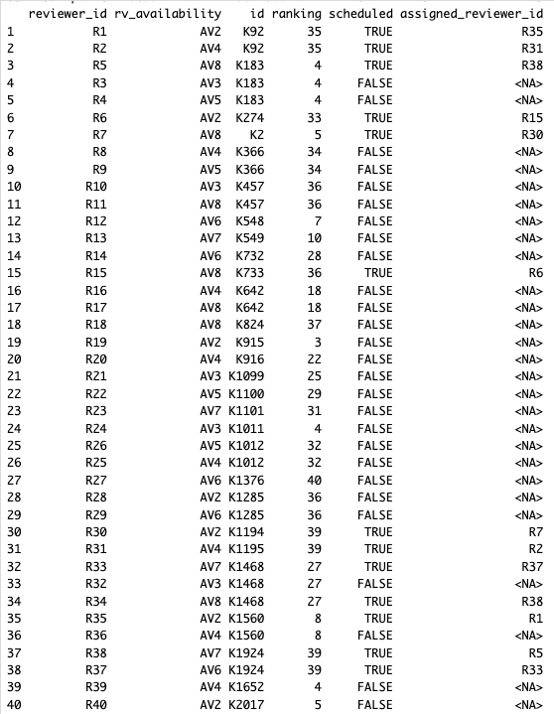
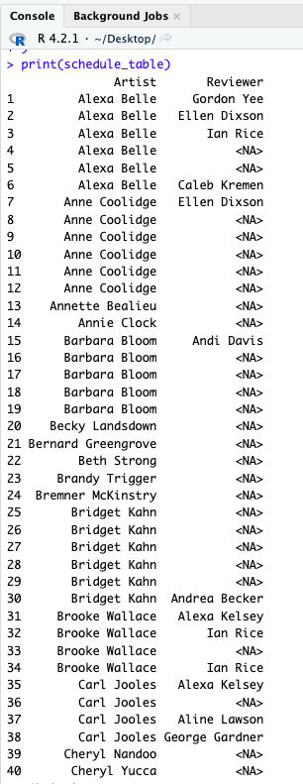
SCHEDULING CODE SNIPPET
z

Slide 14
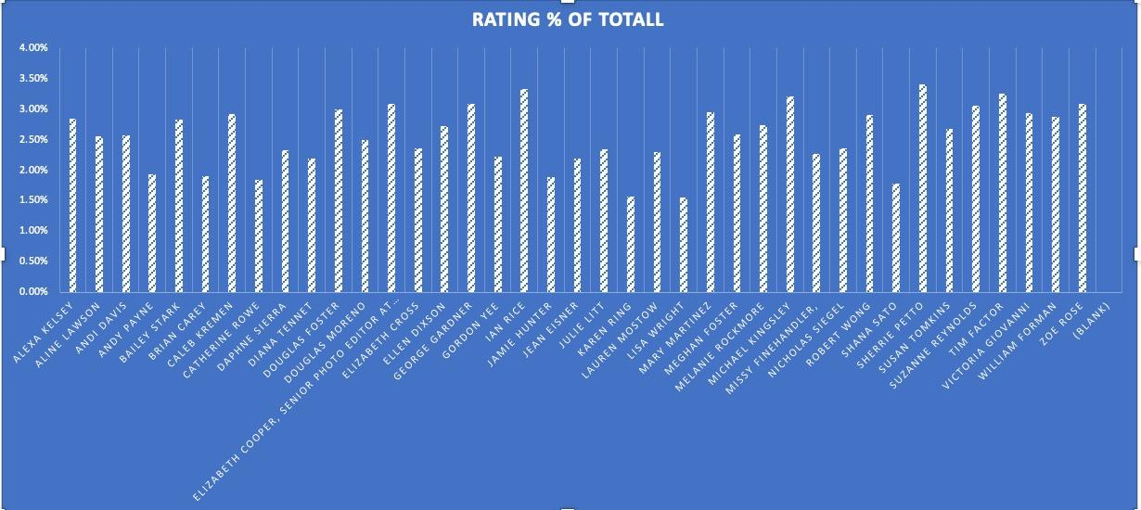
EXPLORATORY DATA ANALYSIS
The visualization shows the overall ratings% given to each reviewer by survey respondents.
Reviewers with consistently lower ratings may indicate a need for improvement or additional training.
Lisa Wright is identified as the most well-liked reviewer based on the analysis.
It helps evaluate the effectiveness of review sessions and identify variations in reviewer performance.
Allows the LACP to assess, compare, and identify patterns or trends in reviewer performance, including outstanding reviewers and areas that require improvement.
z

Slide 15
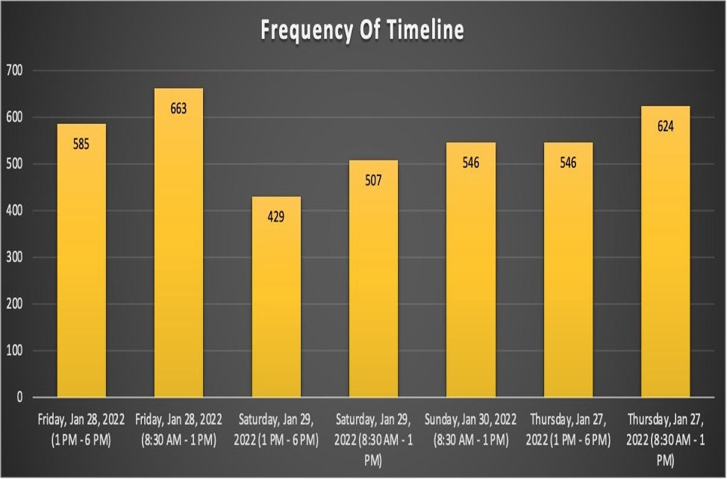
EXPLORATORY DATA ANALYSIS
The visualization clearly shows the distribution of photographers' timeline selections.
Friday is the busiest day of the week for both management staff and LACP reviewers.
Preferences and trends of photographers can be observed through the visualization.
The LACP can gain insights into photographers' preferences for different timelines.
This information can help the LACP in scheduling events and allocating resources effectively.
The visualization can indicate preferred timelines based on higher frequency, guiding event planning and funding decisions.
z

Slide 16
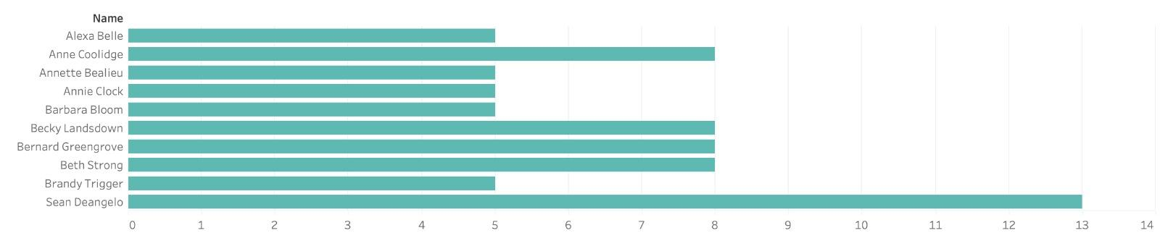
EXPLORATORY DATA ANALYSIS
z
Top ten attendees who reviewed Los Angeles Center of Photography listed in bar plot.
Sean Deangelo received the most reviews (13), followed by three actors with eight reviews each (Anne Coolidge and Annette Beaulieu).
Remaining names on the list have five reviews, suggesting Sean Deangelo had the greatest influence on the center's reputation.
Some attendees submitted only five reviews, indicating they may have participated in a single event or session.
This data helps identify highly involved attendees for potential further engagement or participation.

Slide 17
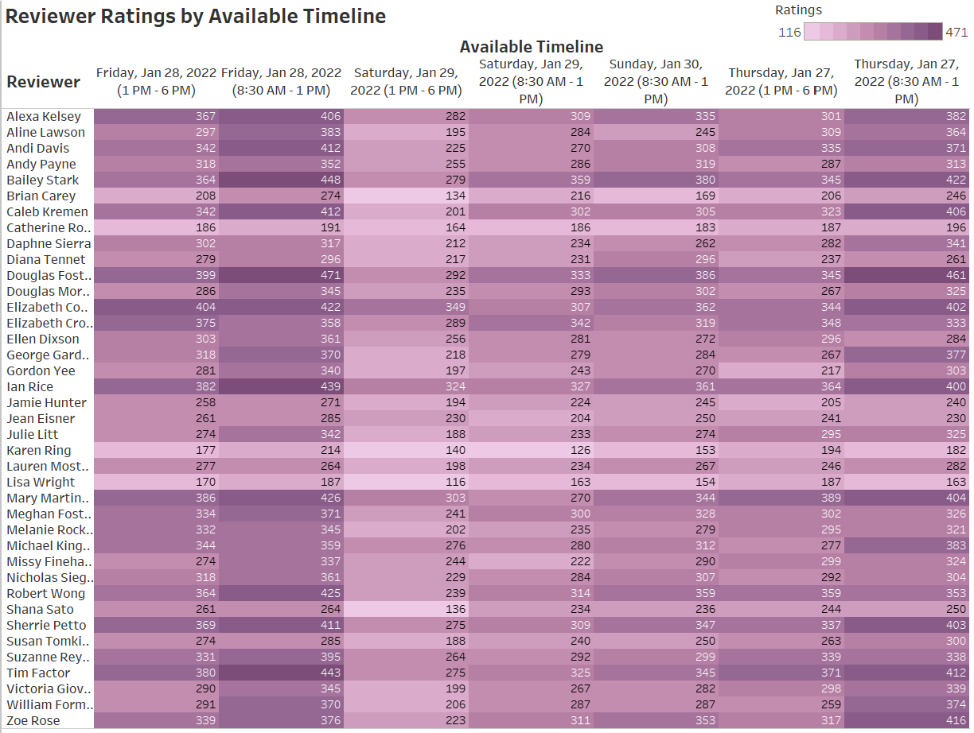
VISUALIZATION ANALYSIS
The visualization "Reviewer Ratings by Available Timeline" presents data on reviewer ratings for different timelines.
Reviewer ratings range from 116 to 471, indicating varying performance levels.
"Douglas Foster" and "Elizabeth Cooper" consistently receive high ratings, indicating reliability and proficiency.
The visualization serves as a starting point for assessing reviewer ratings based on the available timeline.
z

Slide 18
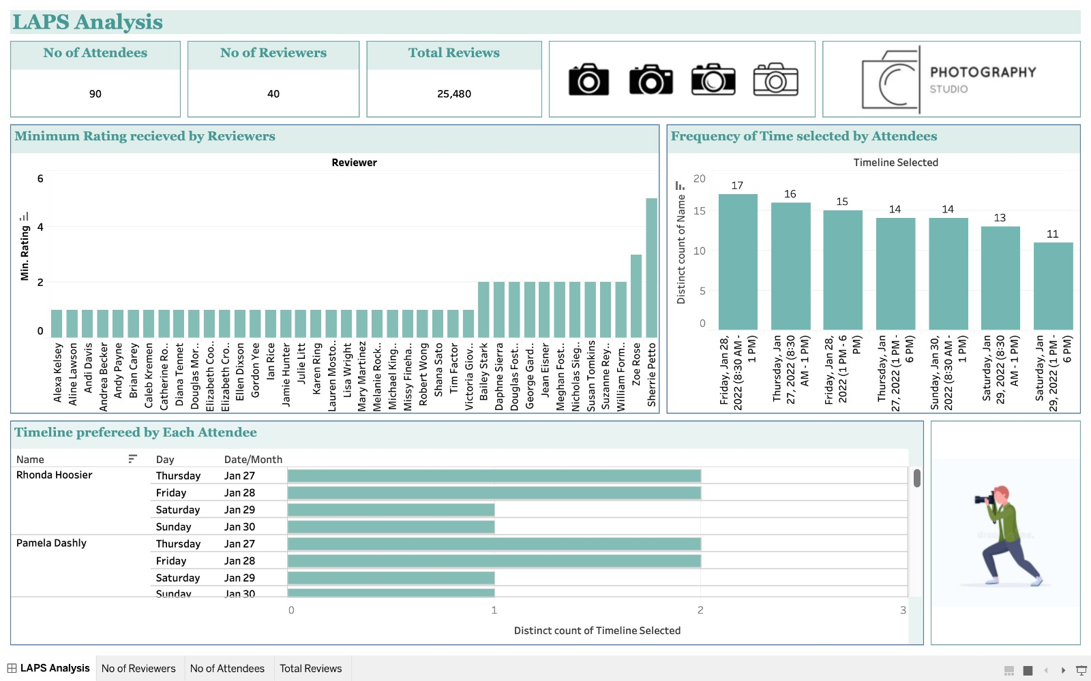
DASHBOARD VISUALIZATION
z

Slide 19
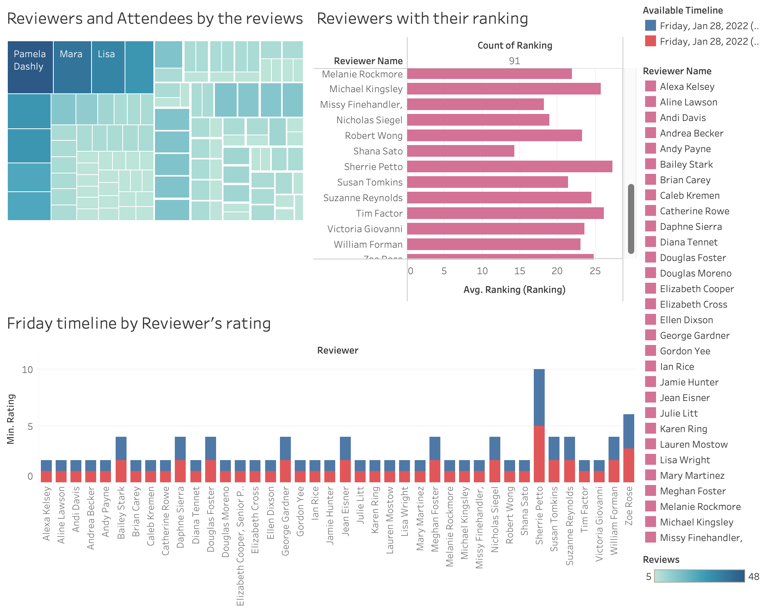
DASHBOARD VISUALIZATION

Slide 20
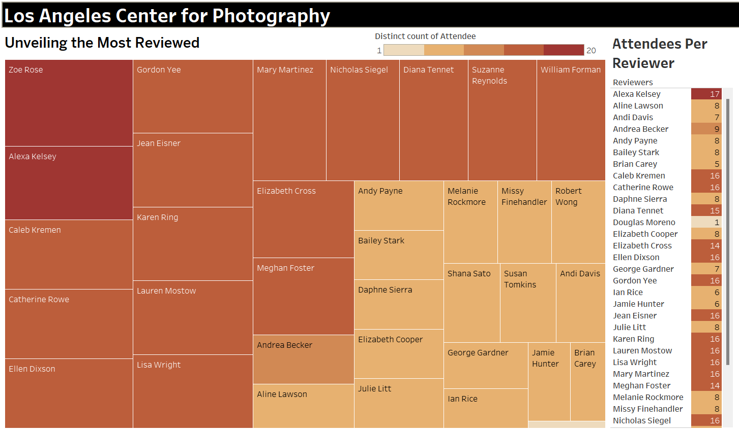
DASHBOARD VISUALIZATION
z

Slide 21
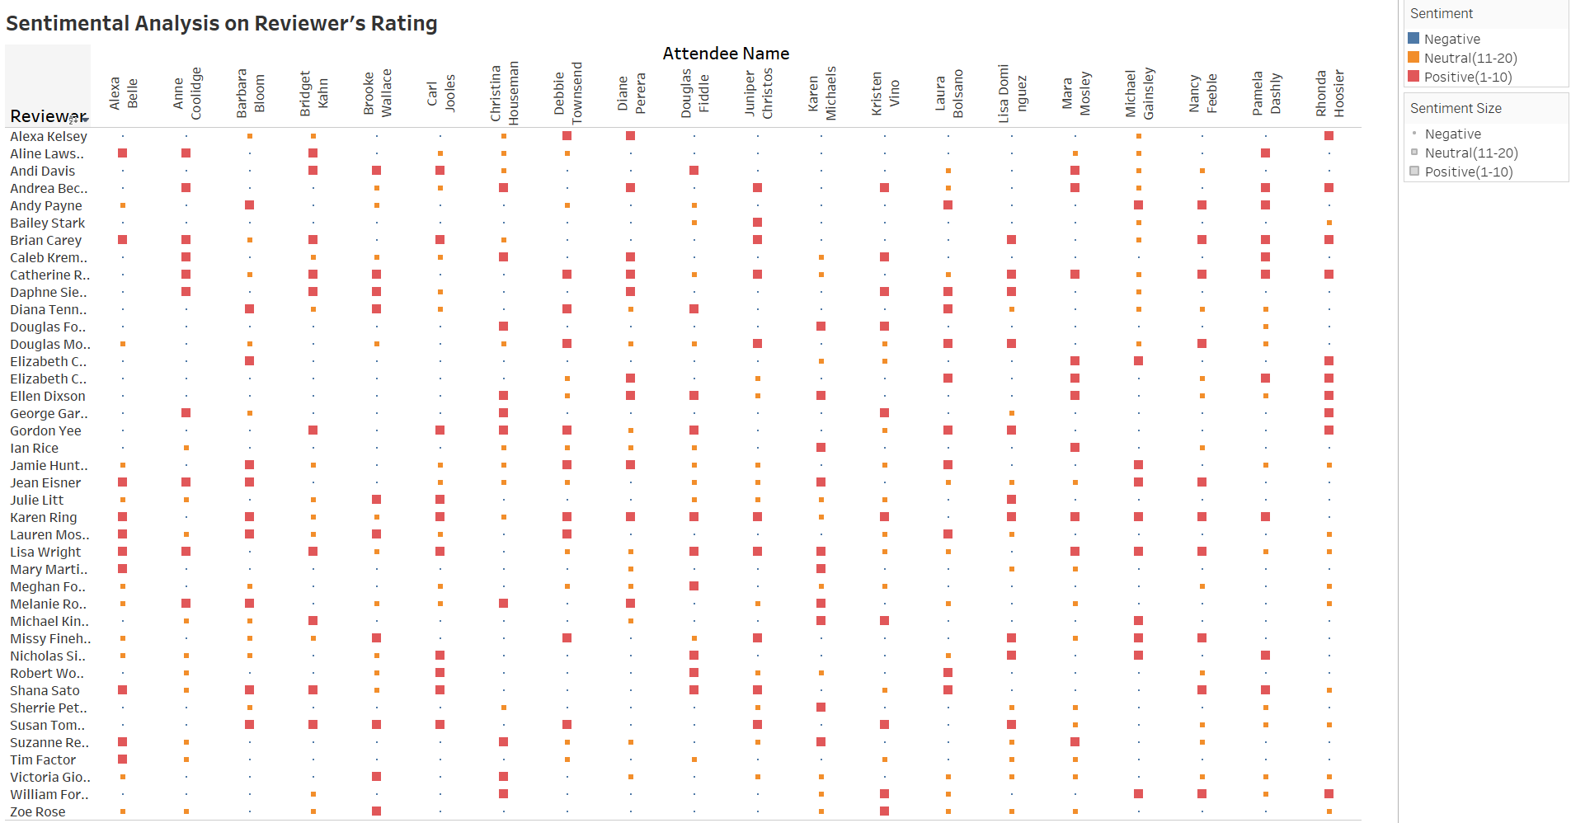
SENTIMENT ANALYSIS VISUALIZATION
z

Slide 22
FUTURE RESEARCH
Implementation: The workflow is being implemented in R or Power Query using tools and libraries that simplify the translation process. Data could have been more consistent, to make the matching algorithm more sustainable and efficient.
Matching Attendees and Reviewers: Advanced algorithms and data structures is utilized to match attendees with their preferred reviewers based on the survey data and preferences. Optimal pairing will be prioritized to ensure attendee satisfaction.
Schedule Optimization: The schedules for each attendee and reviewer will be designed by considering the availability of reviewers and the constraints of their individual schedules. This will help create the best schedules that accommodate both parties.
Effective Communication: It is recommended to use effective communication techniques and provide progress updates to convey the outcomes of unfinished tasks. This ensures transparency and keeps stakeholders informed about the project's status.

Slide 23

CONCLUSION
Program Effectiveness: Our program significantly improves effectiveness and efficiency compared to the current procedure..
Data Preparation: Ensured high data quality through a rigorous data preparation process, including checklists, cleaning rules, and data dictionaries. Data Modelling has been done to final schedule that ensures attendees meet their preferred reviewers in suitable time slots.
Methodical Roadmap: The project's success is facilitated by our systematic roadmap and task allocation among group members.
Success Metrics: Success measured through accurate matching, attendee satisfaction, and optimal schedules.
Refinement and Final Schedule: Refined the program based on feedback, ensuring a final schedule that meets stakeholder requirements.

Slide 24

REFERENCES
Arenas, R. (2022, June 22). How to solve scheduling problems in Python. Medium. https://towardsdatascience.com/how-to-solve-scheduling-problems-in-python-36a9af8de451
Imagine . . . the power of a photograph. The Los Angeles Center of Photography. (n.d.). https://lacphoto.org/
GeeksforGeeks. (2022). Timing Constraints in Real time System. GeeksforGeeks. https://www.geeksforgeeks.org/timing-constraints-in-real-time-system/
Simulannealbnd. MATLAB & Simulink. (n.d.). https://www.mathworks.com/help/gads/simulate-annealing-custom-data-type.htmlLinks to an external site.
ThoughtSpot, T. (2023). What is data visualization? Examples, types and advantages. ThoughtSpot. https://www.thoughtspot.com/data-trends/data-visualization

Slide 25

Thank you!
z

